Slide 1
Lists Introduction to Lists
ICS 3U0

Slide 2
Today’s Agenda
Introduce the concept of an array in Python using the list data type

Slide 3
Arrays and Lists
We have seen various data types so far, including integers, floating point numbers and strings
An array is another fundamental data type in any programming language. In general, arrays consists of a group of elements that are accessed by indexing.
Most programming languages have built-in array data types. Python is no exception – the array data type that we will be studying is called a list.

Slide 4

List Basics
Lists are one of the greatest data structures in Python.
Here is a list of numbers.
>>> x = [1, 2, 3]
And here is a list of strings.
>>> x = ["hello", "world"]
Lists can be heterogeneous. Here is a list containing integers, strings and another list.
>>> x = [1, 2, "hello, "world", ["another", "list"]]

Slide 5
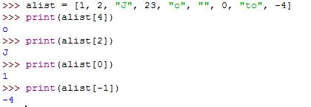
Indexing in Lists
We can access the elements of the list through its indices.
alist = [1, 2, "J", 23, "o", "", 0, "to", -4] print(alist[4])
print(alist[2])
print(alist[0])
print(alist[-1])
1
2
"J"
23
"o"
0
"to"
-4
0 1 2 3 4 5 6 7 8

Slide 6

Indexing in Lists
We can assign values to elements of the array through its indices.
alist = [1, 2, "J", 23, "o", "", 0, "to", -4] alist[5] = -67.8
alist[1] = "dog"
print(alist)
1
2
"J"
23
"o"
0
"to"
-4
0 1 2 3 4 5 6 7 8
This is very important – we can basically assign a value to a specified location in the list

Slide 7
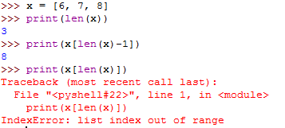
Length of Lists
We can determine the length of a list using the len function
The built-in function len: x = [6, 7, 8]
print(len(x))
print(x[len(x)-1])
print(x[len(x)])

Slide 8

Adding and Multiplying Lists
The + and * operators work on lists, just like strings.
a = [1, 2, 3]
b = [4, 5]
print(a + b)
print(b*3)

Slide 9
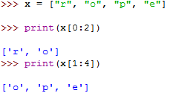
Slicing Lists
We can use list slicing to get part of a list.
x = ["r", "o", "p", "e"]
print(x[0:2])
print(x[1:4])
str1 = "Computer Science"
print(str1[0:8])
What will this output?

Slide 10
Using the for loop with Lists
We can use for loops to cycle through a list in two very different but important ways:
By element
b = [17, "i", 3, 5.6]
for i in b:
print(i)
By index
b = [17, "i", 3, 5.6]
for i in range(len(b)):
print(b[i])

Slide 11
Exercises – Intro Lists
Complete Exercise 5.1 – Day 1

Slide 12
Adding Elements to a List
Example:
x = [1, 2, 3]
Let's say I want to add the numbers 4, 5 and 6 to the end of the list. There are two ways to do it:
x = [1, 2, 3] + [4, 5, 6]
or
x.append(4)
x.append(5)
x.append(6)

Slide 13
Using a FOR loop to Add Elements to a List
Example:
alist = []
for i in range(10):
alist.append(2*i)
print(alist)
alist = []
for i in range(10):
alist = alist + [2*i]
print(alist)
These two programs do exactly the same thing. A list is created that contains the numbers
0, 2, 4, 6, 8, 10, 12, 14, 16, 18

Slide 14
Exercises – Intro Lists
Complete Exercise 5.1 – Day 2

